Slide 1
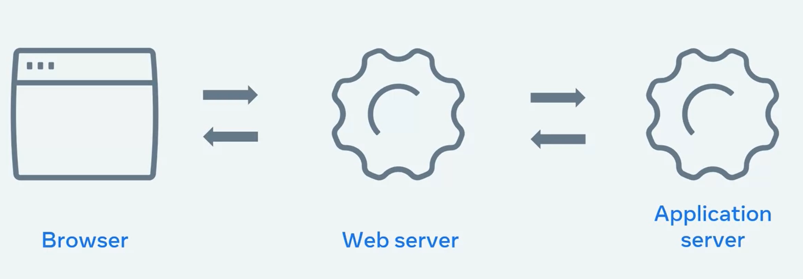
when you log into this course, the web server communicates with an application server to check
that you are in fact enrolled.
The application server confirms your enrollment and specifies what content should show for your profile specifically.

Slide 2
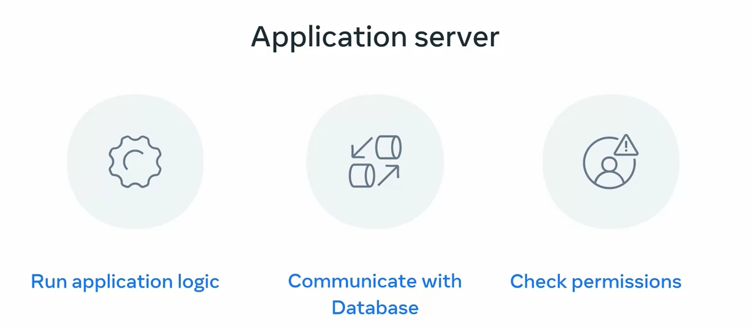

Slide 3
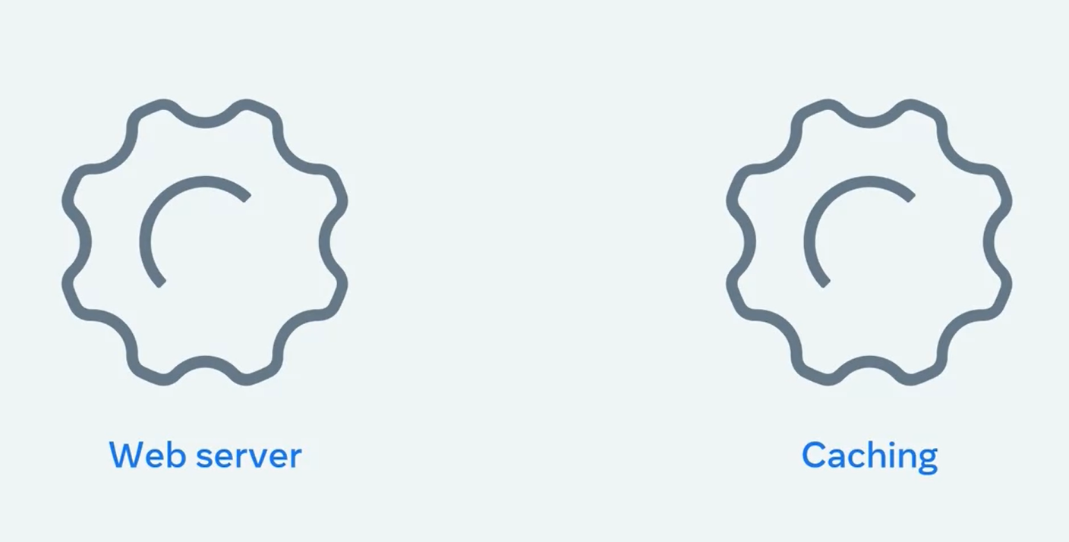
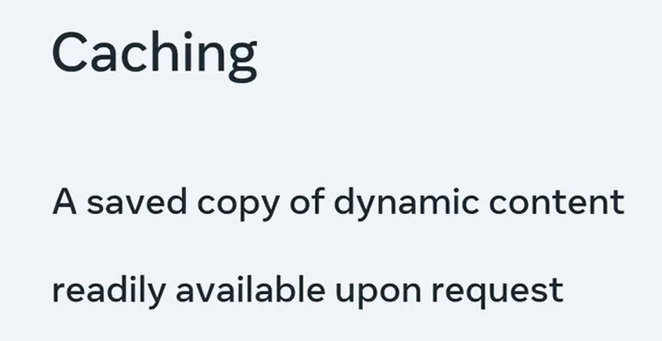

Slide 4
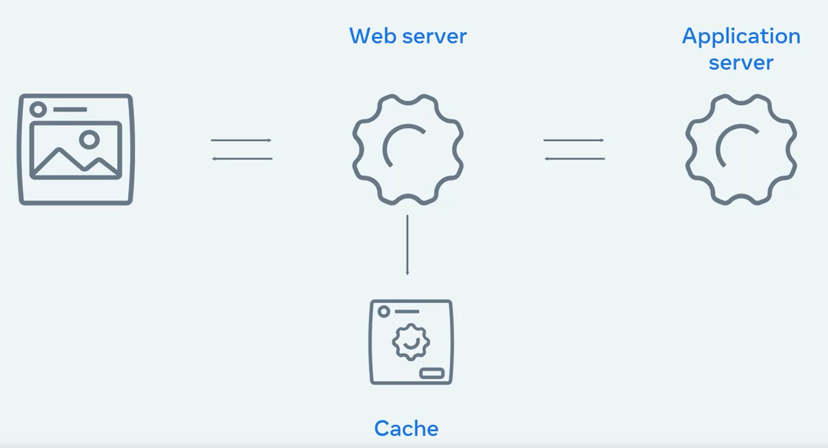
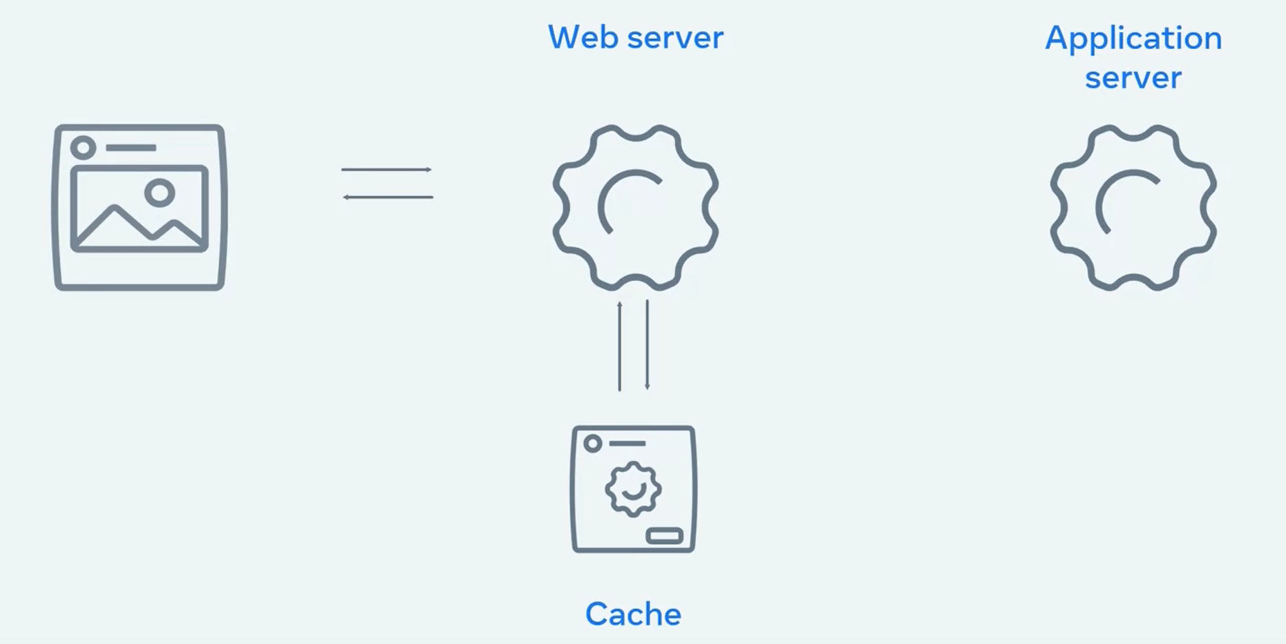

Slide 5
React
As you know, this is called the reconciliation process and can be broken down into the following steps:
Step 1: The virtual DOM is updated.
Step 2: The virtual DOM is compared to the previous version of the virtual DOM and checks which elements have changed.
Step 3: The changed elements are updated in the browser DOM.
Step 4: The displayed webpage updates to match the browser DOM.
As updating the browser DOM can be a slow operation, this process helps to reduce the number of updates to the browser DOM by only updating when it is necessary.

Slide 6
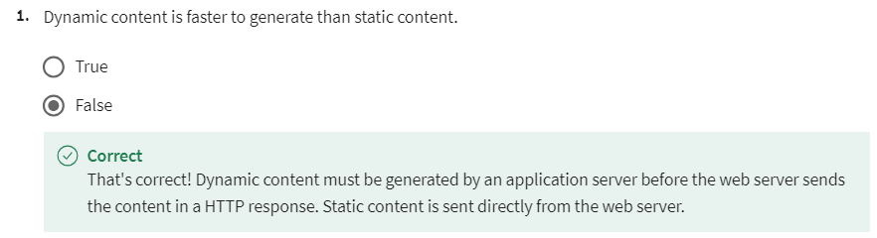
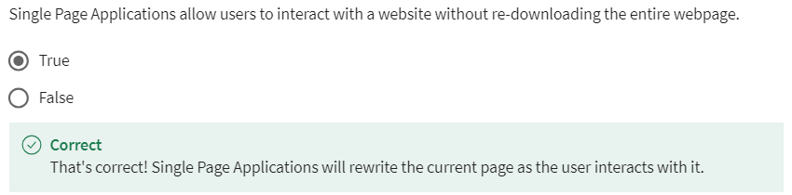
Knowledge check

Slide 7
What are the two main approaches for serving code and resources in a Single Page Application called
Bundling
Code splitting

Slide 8
Bundling
Bundling involves combining multiple JavaScript, CSS, and other static files into a single bundle file or a few bundle files.
The bundling process typically includes minification and compression to reduce file size and improve loading performance.
Bundling simplifies the deployment and delivery of code and resources, as the browser only needs to fetch a few bundle files instead of many individual files.

Slide 9
Code splitting
Code splitting involves breaking the application codebase into smaller chunks or modules and loading them dynamically as needed.
With code splitting, only the code required for the initial page load is loaded upfront, while additional code is loaded asynchronously as the user interacts with the application.
This approach helps reduce the initial load time of the SPA, as only essential code is loaded initially, improving performance.
Code splitting is often used in conjunction with lazy loading, where non-essential parts of the application are loaded on-demand.
Frameworks like React, Vue.js, and Angular provide built-in support for code splitting, allowing developers to optimize the loading of their SPAs for better performance and user experience.

Slide 10

Knowledge check

